Slide 1

VITAL ESSENCE
electronic medical record

Slide 2

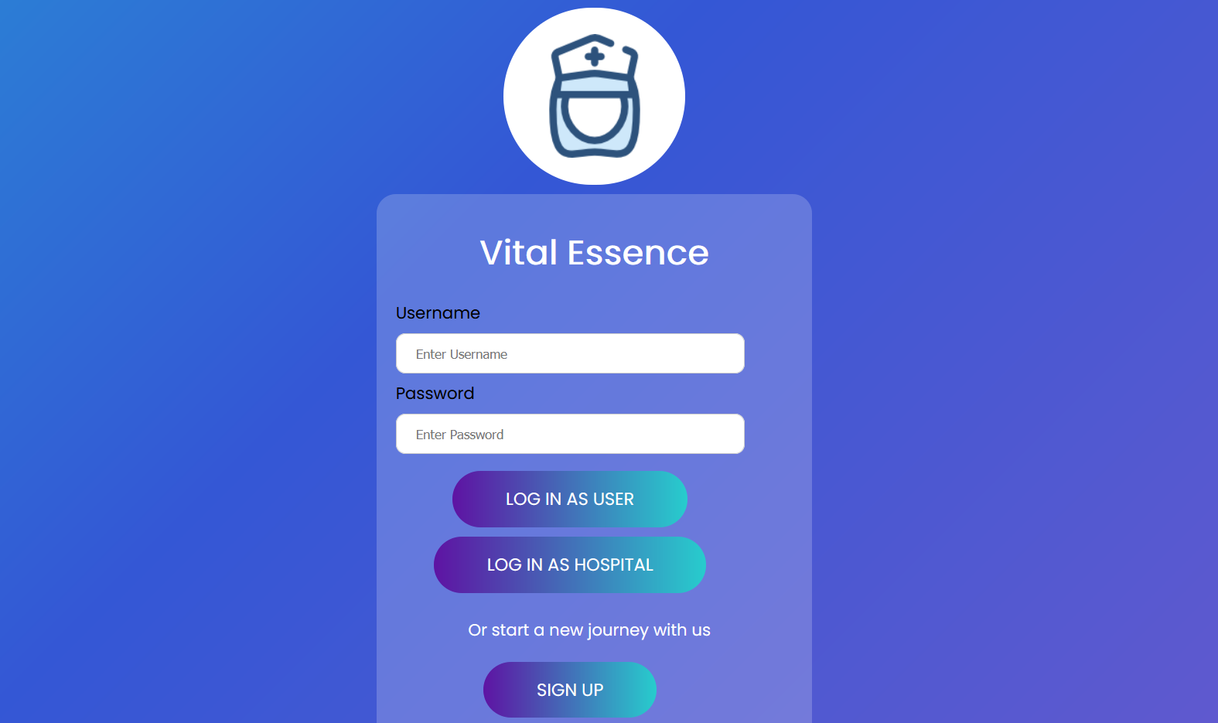


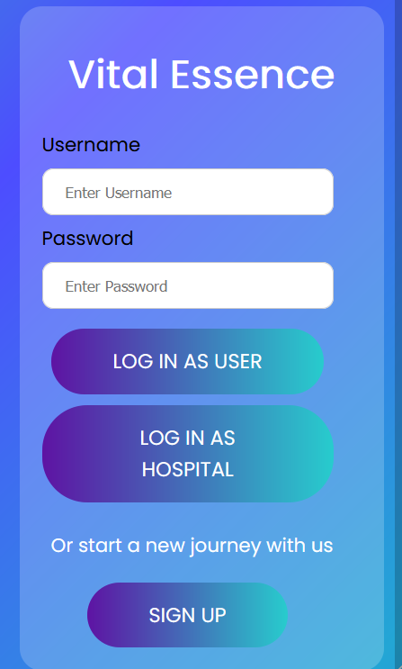
VITAL ESSENCE
Hospital independent patient friendly register

Slide 3
VITAL ESSENCE
A website that stores medical records of users, which helps in case of hospital transfers as the user can easily transfer their medical history to the new hospital.
Special access to emergency details folder of the users for hospitals to treat accident cases in order to get their important medical details using a right index biometric.
(Keeping all privacy issues under consideration)

Slide 4

PROBLEMS FACED
In Case of hospital transfers,the medical history of the patient is not used rather all tests and diagnosis are done from the start.This lead to a lot of wastage of medical resources,time and money.
There is huge delay in treatment in case of accidents as no medical information about the patient is available
All medical reports and prescriptions in paper are difficult to store and manage.Retrieval of a particular report from these files is a tedious task.

Slide 5

HOW CAN VITAL ESSENCE HELP?
In case of hospital transfers, medical reports like scan reports,blood reports,prescriptions etc..can easily be transferred to the new hospital.
Avoid the extra expenses and delay in treatment and continue the treatment right from the stop.
The delay in treatment, caused due to lack of details of the patient in case of accidents can be avoided.
Easy access of medical reports.
Hospital independent patient friendly register.

Slide 6

WHAT CAN VITAL ESSENCE DO ?
User can transfer medical history to a new hospital.
User can add details like test reports and prescriptions to their account through the hospital administration.
Using right index biometric hospitals can access emergency health and contact details of an accident case.
Medical reports can be accessed by the user anywhere anytime, since they are available online.

Slide 7
DEVELOPED USING
CSS
HTML
Bootstrap
JS

Slide 8

COST OF IMPLEMENTATION
AND FEASIBILITY
All the tools and technologies used for developing this website are free, hence the cost of production and development is close to NULL.
All this website requires is a PC or a mobile phone with a good internet connection which makes it affordable for everyone.

Slide 9
STRUCTURE AND DESIGN

Slide 10
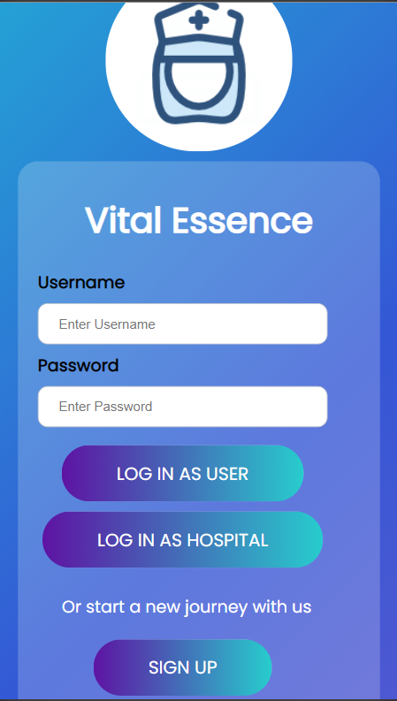
USER ACCESS
User or a hospital can login using their username and password.
If you are a new user start the journey by signing up.

Slide 11
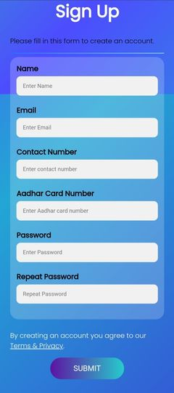

Slide 12
CREATE AN ACCOUNT
To create a new account in the website sign up by giving details like name,email id,contact number, Adhaar card number (for linking biometric address, age,blood group and other important details).
Then create a password and submit to complete the procedure.

Slide 13
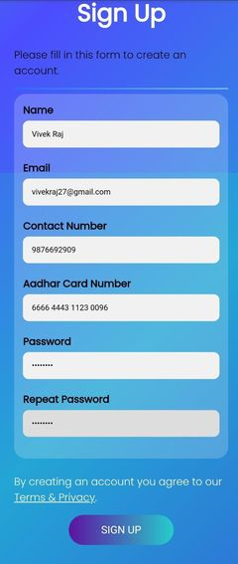


Slide 14
WELCOME TO
VITAL ESSENCE
Lets begin a new journey here...

Slide 15
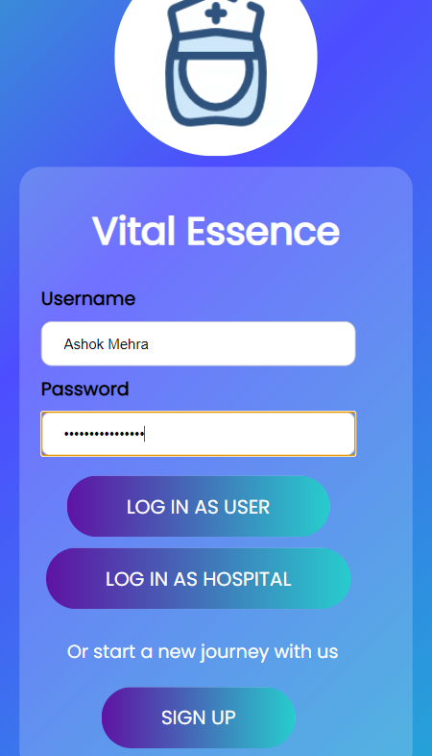
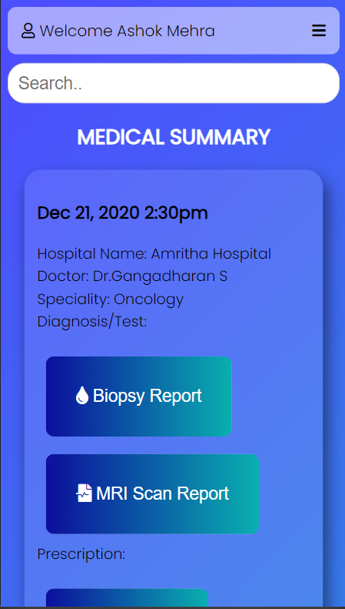

Slide 16
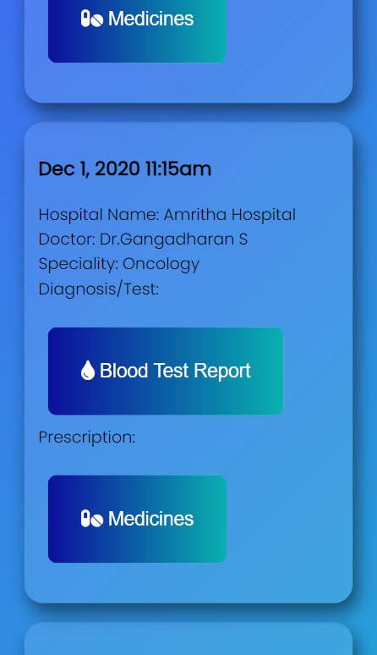


Slide 17
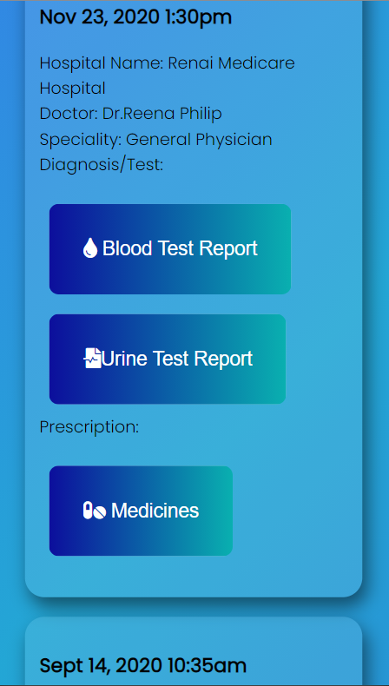
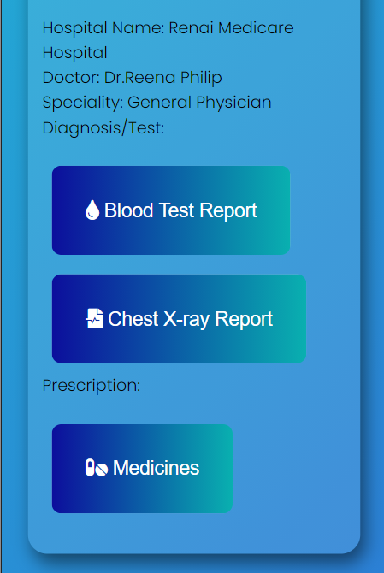

Slide 18
USER ACCESS
This is the welcome user page or the home page of the user. Here the user can view the complete details (date, time, doctors name, speciality, all test reports and medicine prescriptions) of each hospital visit.
Using the search option on the top the user can search for his details with regard to any of the fields. (this feature is in work in progress state).

Slide 19


Slide 20
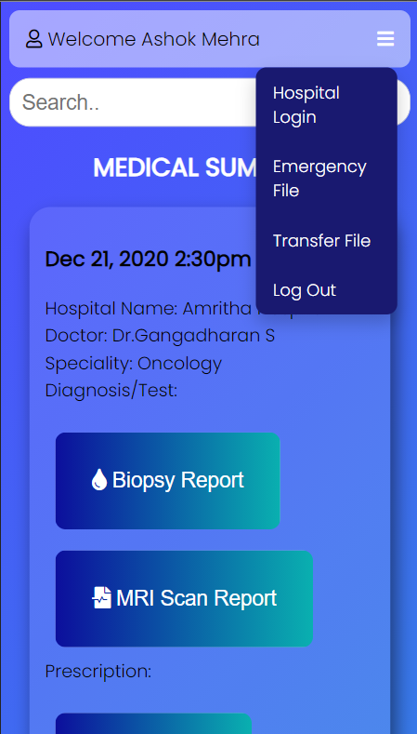
USER ACCESS
The settings dropdown option on the top right corner of this page gives four options.
Hospital login-which opens a modal showing details of all the biometric access of this account made by hospitals in case of emergencies
Emergency File-which leads to a page where the user can edit his/her emergency file.
Transfer File-it transfers the entire medical history to a new hospital(this option is currently in work in progress state).
Log out

Slide 21
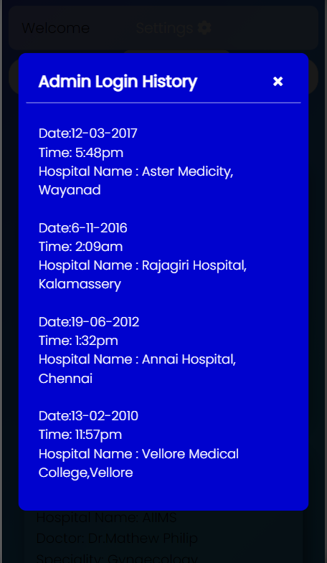

Slide 22
USER ACCESS
A modal showing details of all the biometric access of this account made by hospitals in case of emergencies.
The date,time ,name of the hospital from where the emergency details file of the user was accessed in case of emergencies like accidents

Slide 23
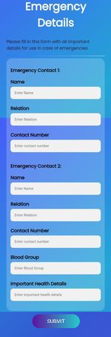

Slide 24
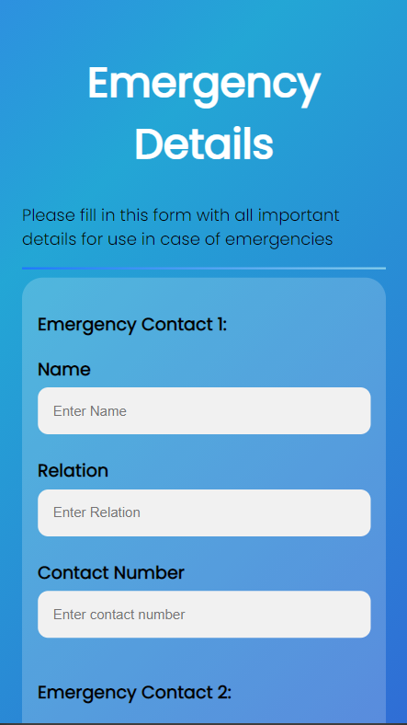
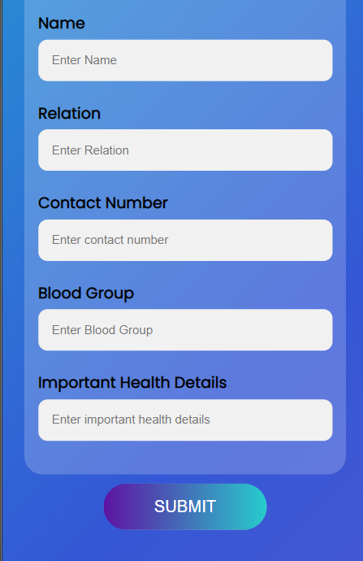

Slide 25
USER ACCESS
All the emergency details filled here will be accessible by hospital authorities using the biometric login in case of an accident.
Two emergency contact details (their name ,and contact number),other important health details like blood group,any allergies to certain medicines,recent surgeries or chronic diseases if any.
User can edit this page anytime.
On clicking Submit takes the user back to the Home Page.

Slide 28
HOSPITAL ACCESS
Hospitals can login using their username and password.
Which leads to the Hospital Login Page

Slide 29
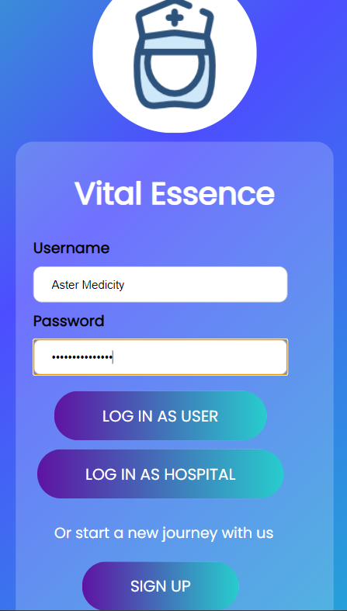
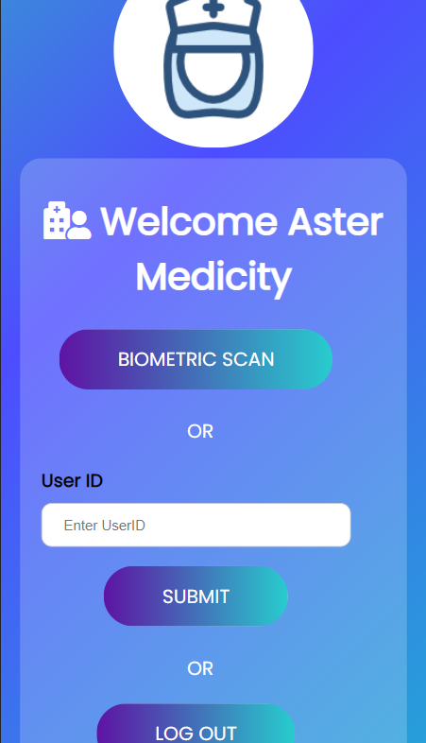

Slide 30
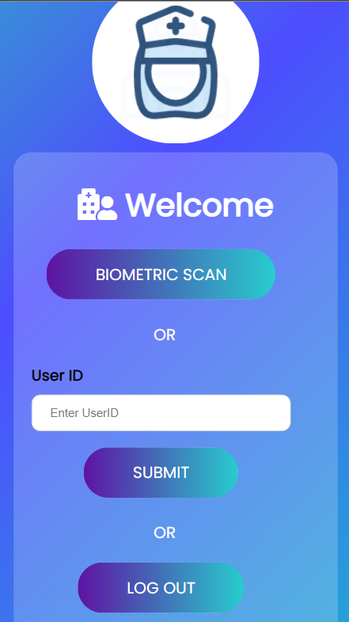
HOSPITAL ACCESS
BIOMETRIC SCAN option allows hospitals to scan the right index biometric of patients who met with accidents. In order to retrieve more information about the patient like emergency contact details and important health details
The biometric scanning using the right index of the patient is under work in progress
As of now clicking this button takes the hospital admin to an emergency details page of that particular patient.

Slide 31
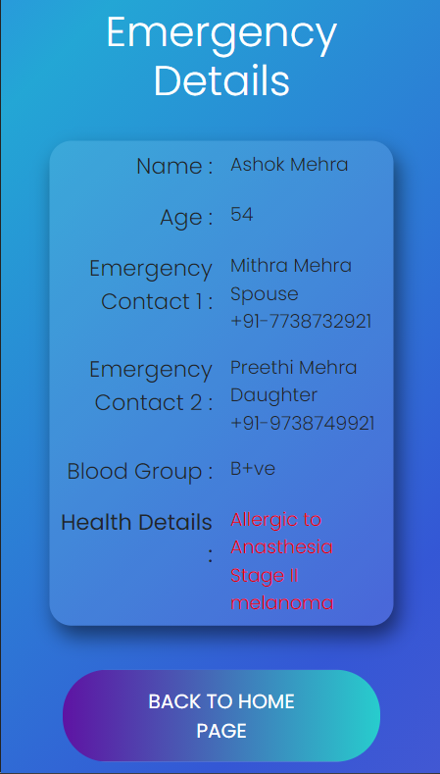

Slide 32
HOSPITAL ACCESS
Emergency Details page which comes as a result of the biometric scanning.
The hospital gets to see the name,age,two emergency contact details, blood group and important health details like allergies to certain medicines or chronic diseases if any.
On clicking Back to Home Page takes the hospital admin back to the Home Page.

Slide 33
HOSPITAL ACCESS
USER ID option allows hospitals to add the medical reports, prescriptions and further details of the hospital visit of a patient .
They can update the patient’s account by accessing it through the user id.
On clicking the submit option the patient gets a notification message that this particular hospital is trying to add more files to your account. Then it is upto the patient to allow or deny this process.
Only with permission of the patient will the hospital be able to continue the process.

Slide 34
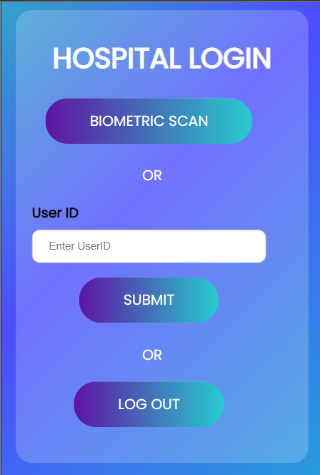
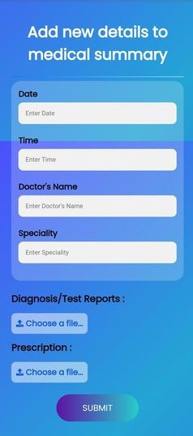

Slide 35
HOSPITAL ACCESS
The hospital can add details like date, time, name of the doctor consulted, speciality of the doctor and also attach files of the diagnosis, test reports (like blood test,ECG tests,scanning reports,etc)and the medicines prescribed.
The hospitals cannot view or edit any other details of the patient as direct access to the patient’s account is not given thereby ensuring protection and privacy of patient details.
On completion of the process click submit which takes the hospital admin back to the Home Page.

Slide 36
WORK IN PROGRESS
Hospital transfers
User can transfer entire medical summary to a new hospital using the transfer files option in the settings dropdown of the welcome user page.
User will be notified through mail and message when a hospital tries to access the emergency details folder in the account in case of accident emergencies using biometric right index scan.

Slide 37
WORK IN PROGRESS
Hospital trying to add files
When a hospital tries to add details( test reports and prescriptions) by giving the user id the user will be notified with a message with allow and deny access options.
Only when the user allows the hospital to add files will the hospitals be able to do so.

Slide 38
WORK IN PROGRESS
Updation in the users account
The test reports, prescription and other details regarding the hospital visit which the hospital added to the users account with user’s permission will be updated to the medical summary of the user’s account.
The details of emergency access using biometric by hospitals in case of accidents will be updated in the hospital login details of the settings dropdown option in the welcome users page.

Slide 39



FUTURE POSSIBILITIES
Provision for user to make appointments to consult a doctor.
Medicine prescriptions can directly be transferred to pharmacies and payment procedure can also be added.
Bills of the medical tests and medicine prescriptions can also be stored which can be useful in redemption of medical insurances.

Slide 40
FUTURE POSSIBILITIES
Provision for user to apply for medical certificates to concerned doctors for medical leave or other purposes can be enabled.
Face recognition and eye prints can also be added along with fingerprints for biometric scan.
A certified doctor can also be given access to add reports/diagnosis and prescription with user’s permission.

Slide 41
TEAM IGNITERS
Anitha S Menon [Team Leader]
Jabira Farhath M A
Karthika R
Shimil Shaji Abraham

Slide 42


